Slide 1

Billboard Song Prediction Project
Teammates: Sarah D. Hood, Jini Hassan, Ryan Eccleston-Murdock, Wasif Khan, Angeli Lucila, Ivana Korak

Slide 2
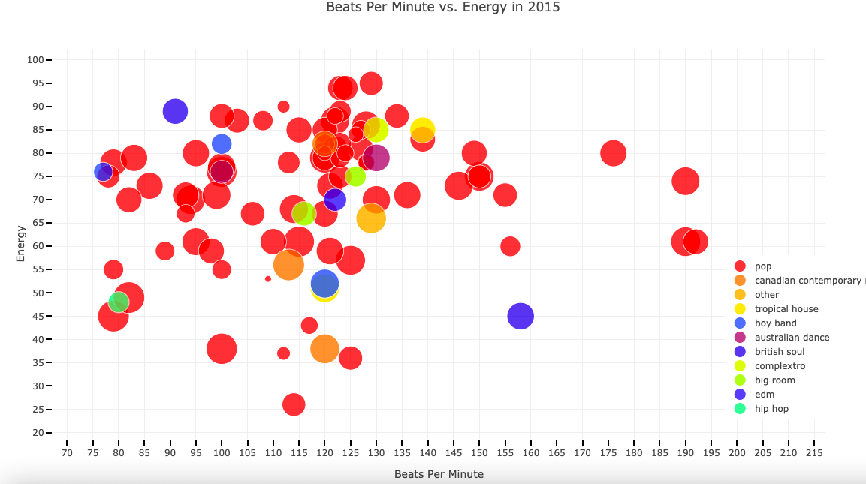
Inspiration and Goal
Building on past project
Rise of British Soul - could we predict?
Try to predict song attributes/genres that will be in the next hit songs
Models:
Time Series?
Logarithmic
SVM
Plan:
Billboard weekly top 100 songs
Predict next week’s hits

Slide 3
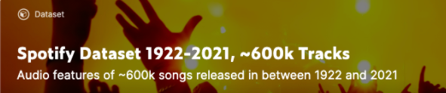

Datasets
CSV: Spotify songs with attributes 1922-2021
CSV: Billboard weekly top 100 1958-2020
Scraping: Billboard weekly top 100 2021
Calls to Spotify API for unique Spotify IDs and/or song attributes

Slide 4
Workflow Overview
Clean existing CSVs
Scraping Billboard
Make Spotify API calls
Join CSVs on Spotify ID
Prepare the data for modelling
Run the models

Slide 5
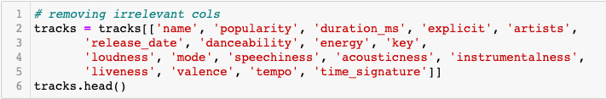
CSV cleaning: code
Cutting to 2018 - 2020
Data types: datetime
Cleaning strings
Filling NaNs
Removing unnecessary columns

Slide 6
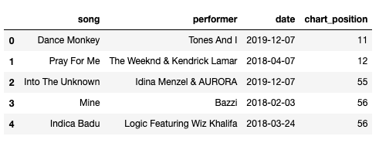
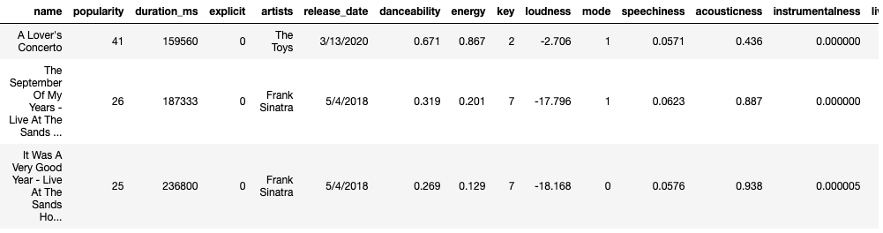
CSV cleaning: Results

Slide 7
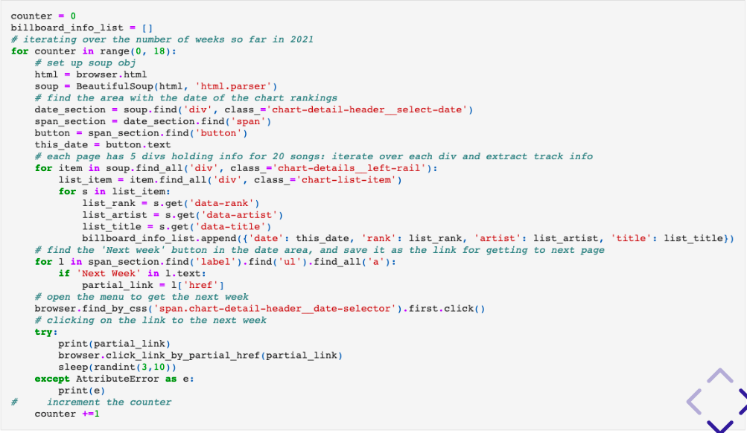
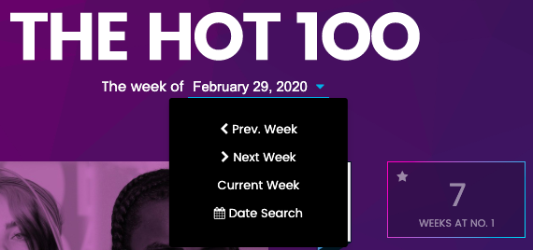
Billboard Scraping: Code & Challenges

Slide 8
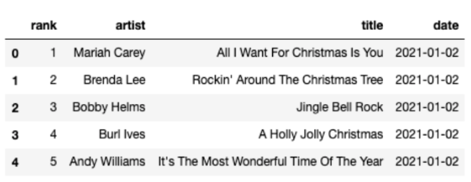
Billboard Scraping: Results

Slide 9
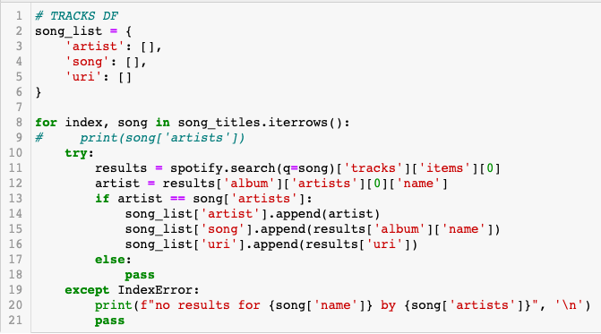
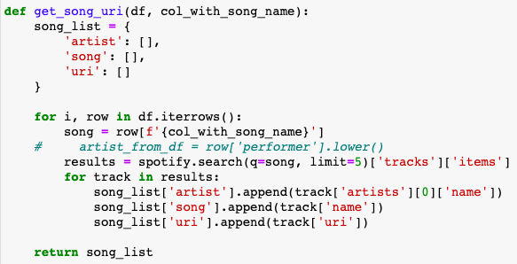
Spotify API calls

Slide 10

Spotify API calls: Challenges
Time
Results per track

Slide 11
Change of Direction!

Slide 12
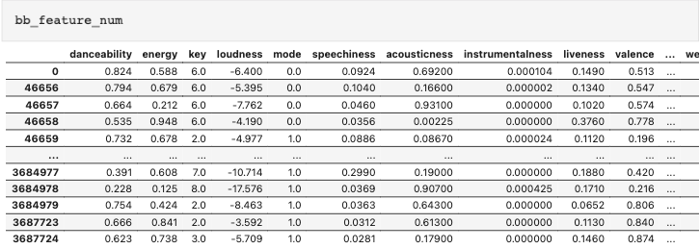
Problems with our current inputs...
Preliminary models: song attributes don’t have much predictive ability
Better factors
Time limit: only 2018 - 2020 data

Slide 13
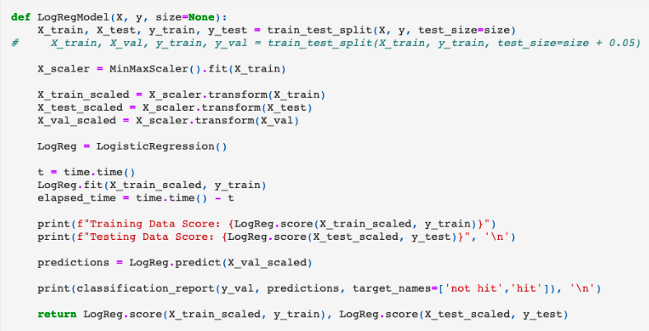
Logarithmic Model: Code

Slide 14
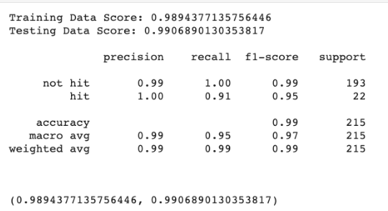
Logarithmic Model: Results

Slide 15
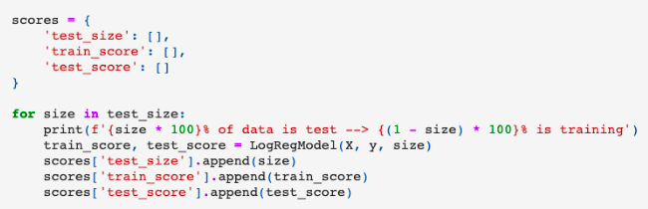
Modulating Test and Training Percentages

Slide 16
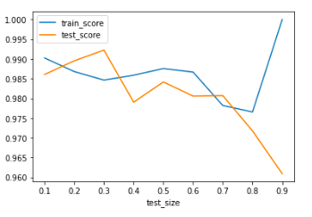
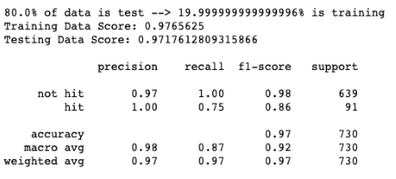

Slide 17
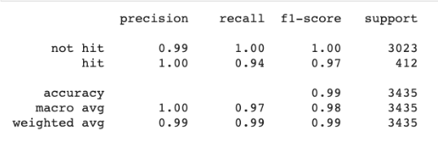
SVM Model

Slide 18
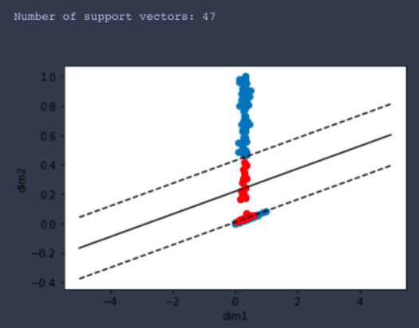
SVM: Graphed

Slide 19
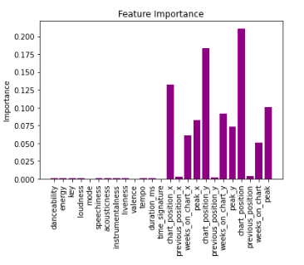
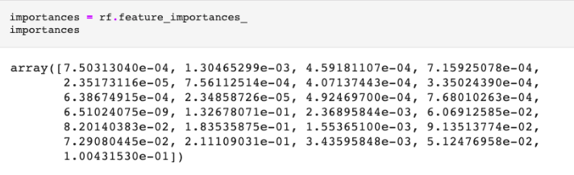
Random Forest: Scoring the Model

Slide 20
Future Directions/Do-Overs
Getting advice about type of model earlier
Not clipping the 2018-2020 dataset to take away the weeks on the chart and top ranking columns
Add in the 2021 data to make it up to date
Make the model live on a website, with data in a database, updated every week

Slide 21
Thank you!
Model advice
Repo example
Help with scraping

Slide 22
Questions?

